Slide 1


12th International Young Scientists Conference on Computational Science
Determination of Optimal Locations
for ATM Network Service Points
Kamila Takenova, Valentina Y. Guleva
ITMO University

Slide 2


Subject of research
The object of the study is a network of ATMs
The subject of the study is the effectiveness of customer service by points of the ATM network
Key problems:
lack of an integrated approach to solving the problem of placing network service points,
simplification of optimization tasks,
difficulty in assessing the effect of the techniques used
2

Slide 3
Goal and tasks
The goal is to find the most effective algorithm for constructing a complex network of service points (ATMs)
Tasks:
key research models’ identification,
formation of the model structure, including mathematical formulation,
implementation of algorithms,
assessment of the effectiveness of the applied methods,
general conclusions’ formulation
3

Slide 4
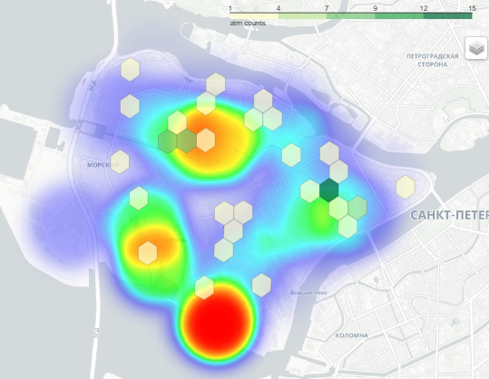
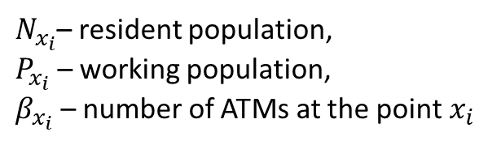
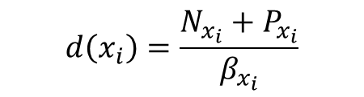
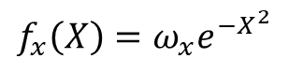
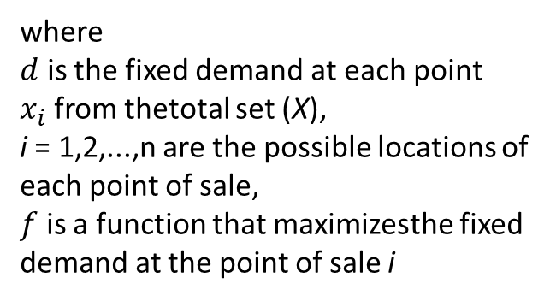

Demand maximization model
Source: OpenStreetMap
$$max\sum_{i}{f_{i}\left(d\left(x_{i},X\right)\right)}$$
Network load (person/ATM)
where
$d$ is the fixed demand at each point $x_{i}$from thetotal set (X),
i = 1,2,...,n are the possible locations of each point of sale,
$f$ is a function that maximizesthe fixed demand at the point of sale i
$$ⅆ\left(x_{i}\right)=\frac{N_{x_{i}}+P_{x_{i}}}{β_{x_{i}}}$$
$f_{x}\left(X\right)=ω_{x}ⅇ^{−X^{2}}$
$N_{x_{i}}$– resident population,
$P_{x_{i}}$ – working population,
$β_{x_{i}}$ – number of ATMs at the point$x_{i}$
ATMs on the working population density map
4

Slide 5
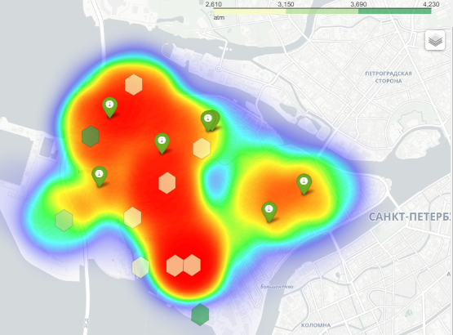
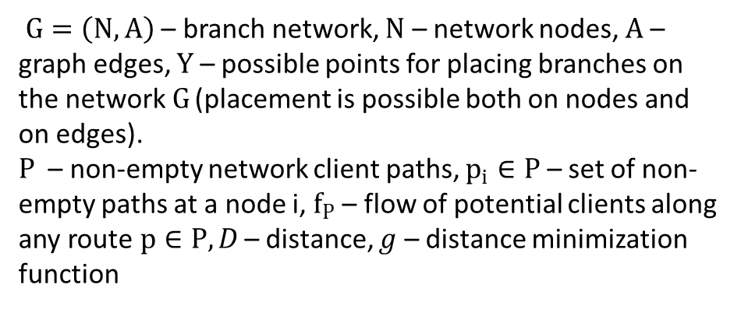
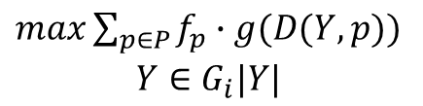

Combined model
Source: OpenStreetMap
Local population:
Network load (person/ATM)
+ setting weight using PageRank method
$$max\sum_{i}{f_{i}\left(d\left(x_{i},X\right)\right)}$$
Passers-by customers:
$\begin{aligned}max\sum_{p∈P}{f_{p}∙g(D(Y,p))} \\ Y∈G_{i}|Y|\end{aligned}$
$G=\left(N,A\right)$ – branch network, $N$ – network nodes, $A$ – graph edges, $Y$ – possible points for placing branches on the network$G$ (placement is possible both on nodes and on edges).
$P$ – non-empty network client paths, $p_{i}∈P$ – set of non-empty paths at a node i, $f_{P}$ – flow of potential clients along any route$p∈P, D$ – distance, $g$ – distance minimization function
Points are priority locations for ATM placement according to the mini-sum distance model,
Polygons are priority locations for ATM placement according to the market share maximization model,
Heat map – working and living population
5

Slide 6
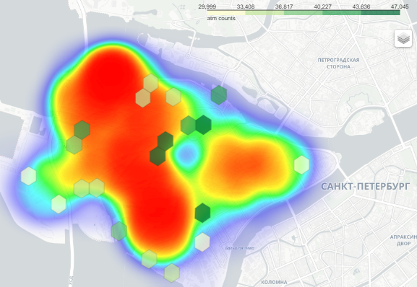
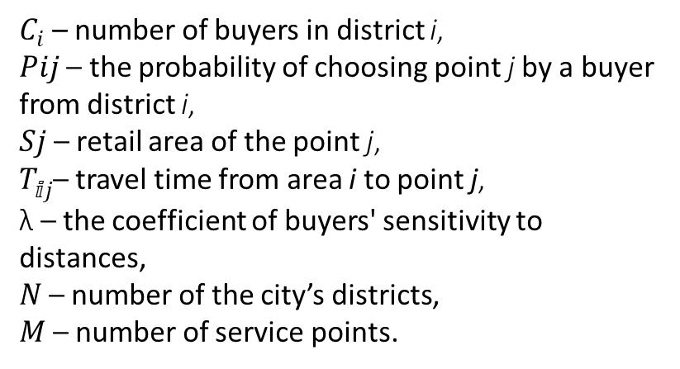
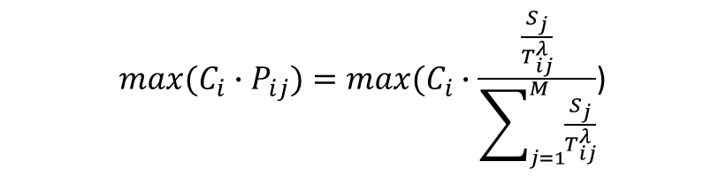
The probabilistic Huff model
The building density factor influenced on the right-hand shift of service points' location
${max⁡(C_{i}∙P}_{ij})=max⁡(C_{i}∙\frac{\frac{S_{j}}{T_{ⅈj}^{λ}}}{\sum_{j=1}^{M}{\frac{S_{j}}{T_{ⅈj}^{λ}}}}$)
Simulation result:
Maximal network load (person/ATM)
$C_{i}$ – number of buyers in district i,
𝑃𝑖𝑗 – the probability of choosing point j by a buyer from district i,
𝑆𝑗 – retail area of the point j,
$T_{ⅈj}^{ }$– travel time from area i to point j,
λ – the coefficient of buyers' sensitivity to distances,
𝑁 – number of the city’s districts,
𝑀 – number of service points.
6

Slide 7
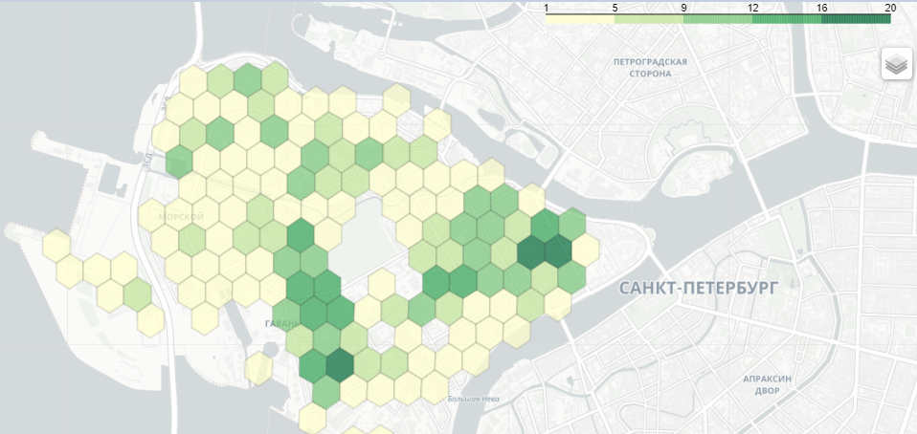
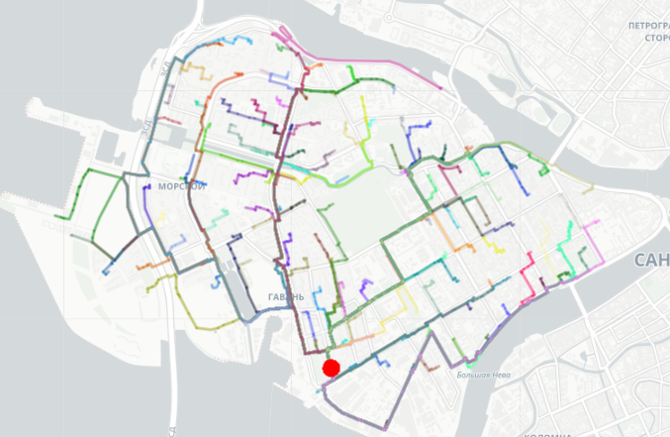
The probabilistic Huff model
The building density factor influenced on the right-hand shift of service points' location
Building density (number of buildings in the polygon)
Building density polygons (retail area)
Shortest paths to a certain ATM
7

Slide 8
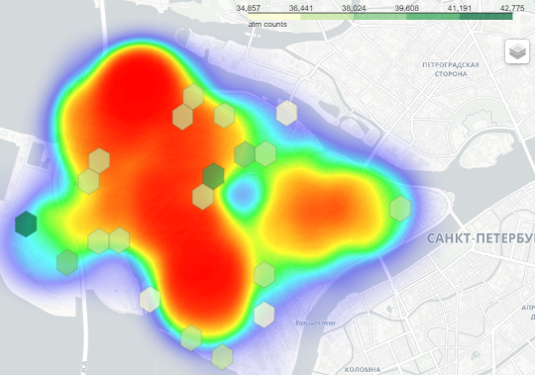
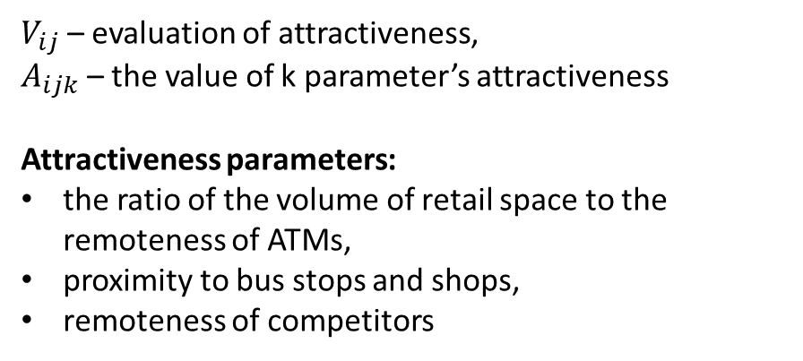
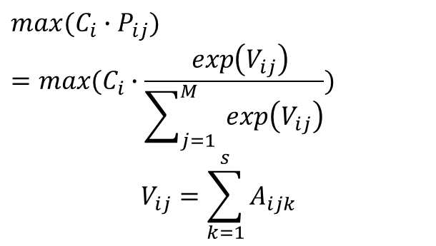
The McFadden Model
Simulation result:
$${max⁡(C_{i}∙P}_{ij})$$
$$=max⁡(C_{i}∙\frac{ _{ }^{ }\exp\left(V_{ij}\right)}{\sum_{j=1}^{M}{ \exp\left(V_{ij}\right)}})$$
$$V_{ij}=\sum_{k=1}^{s}{A_{ijk}}$$
Maximal network load (person/ATM)
$V_{ij}$ – evaluation of attractiveness,
$A_{ijk}$ – the value of k parameter’s attractiveness
Attractiveness parameters:
the ratio of the volume of retail space to the remoteness of ATMs,
proximity to bus stops and shops,
remoteness of competitors
The competition factor influenced on the left-hand shift of service points' location
8

Slide 9
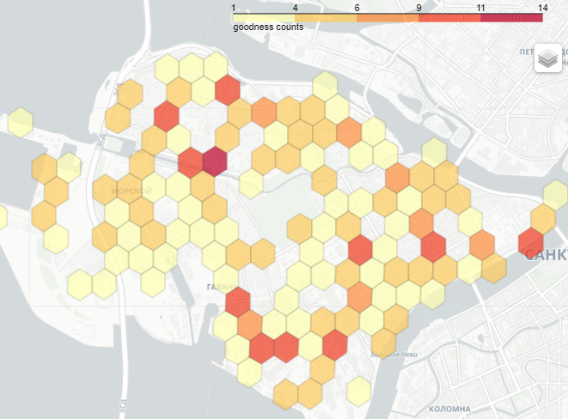
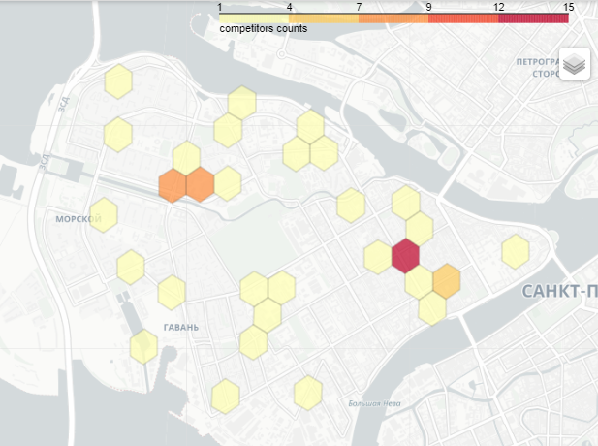
The McFadden Model
The competition factor influenced on the left-hand shift of service points' location
Density of shops and bus stops
Density of competing ATMs' placement
9

Slide 10
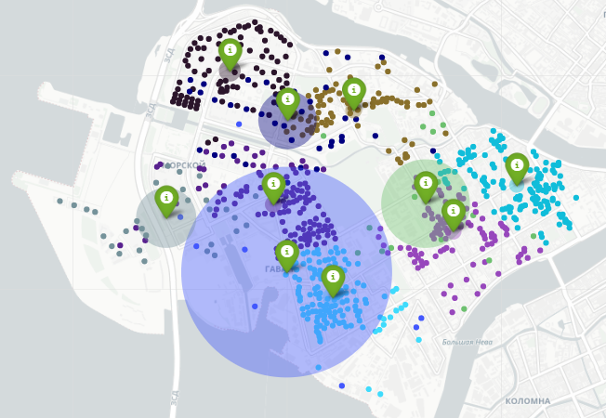
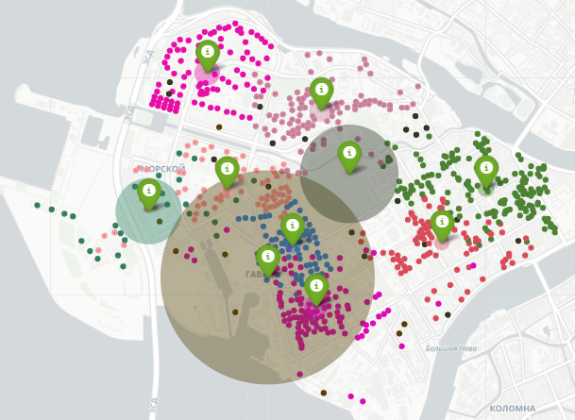
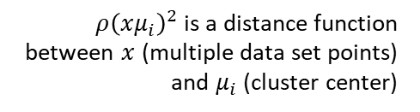
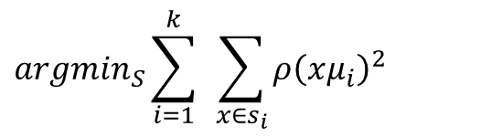
Clustering by building density
$${argmin}_{S}\sum_{i=1}^{k}{ }\sum_{x∈s_{i}}{ρ{\left(xμ_{i}\right)}^{2}}$$
$ρ{\left(xμ_{i}\right)}^{2}$ is a distance function between $x$ (multiple data set points) and $μ_{i}$ (cluster center)
k-means
Hierarchical clustering
10

Slide 11
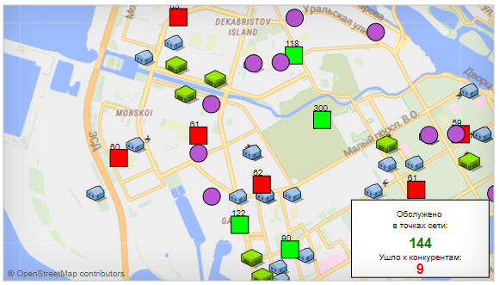
Simulation model
Expected result: assessment of the effectiveness of the considered models in terms of the number of clients served and those who went to competitors
Idea: modeling takes place on the basis of two types of agents - ATMs and clients.
Clients are generated by green and blue tents. ATMs are static and shown as multi-colored squares.
In the process of imitation, the client arrives, is served, goes to the starting point, or goes to a competitor. The ATM agent monitors the readiness status of each ATM instance.
Designations:
Serviced at network points
The ATM is free and ready to use
Client generation point (residential building)
Went to competitors
ATM requires loading banknotes
Customer generation point (stop/store)
Competitor ATM
11

Slide 12
Final comparison
The best model by the metric of the number of clients served is the spatial hierarchical clustering model. Advantages of use: ease of implementation, scalability to large data sets. Disadvantages: sensitivity to outliers that distort the average; duration of execution of the algorithm due to the iterative approach.
In terms of incoming customer flow retention metrics, the best is the McFadden model. Highlighting the competition factor had a positive effect on customer retention rates.
The combined model took second place in both metrics. By distinguishing two types of client flow, this model turned out to be more balanced in terms of network load.
The Huff model is sensitive to assessing the parameters of the attractiveness of service points, and in the simplest model there is an underestimation of the influence of the spatial factor and the competition factor, therefore, for these models we see the lowest results.
12

Slide 13
Thanks for your attention

